Slide 1

The Enterprise Clown
Builds SharePoint apps
with Node.js
@bjartnes and @TheEnterpriseClown
Notes:
The Enterprise Clown is really excited as this is his first public appearance, possibly his last?
I am Bjørn Einar Bjartnes and I am the Enterprise Clown. Bjartnes works in Computas, come see us at the stand in the hall.
What is an Enterprise Clown? Does stuff that does not not traditionally belong in the corporate world
I don’t have time to explain why the clown is a clown.
If you feel you need an explanation before I move on, pick one:
- The clown is at risk of being laughed at/ridiculed, therefor he hides behind a clowns mask
The Enterprise and its flawed reasoning makes him sad. The smile is ironic.
Coding SharePoint solutions on Linux in VIM makes him feel like The Joker
If you are more like me, make up you own theory

Slide 2
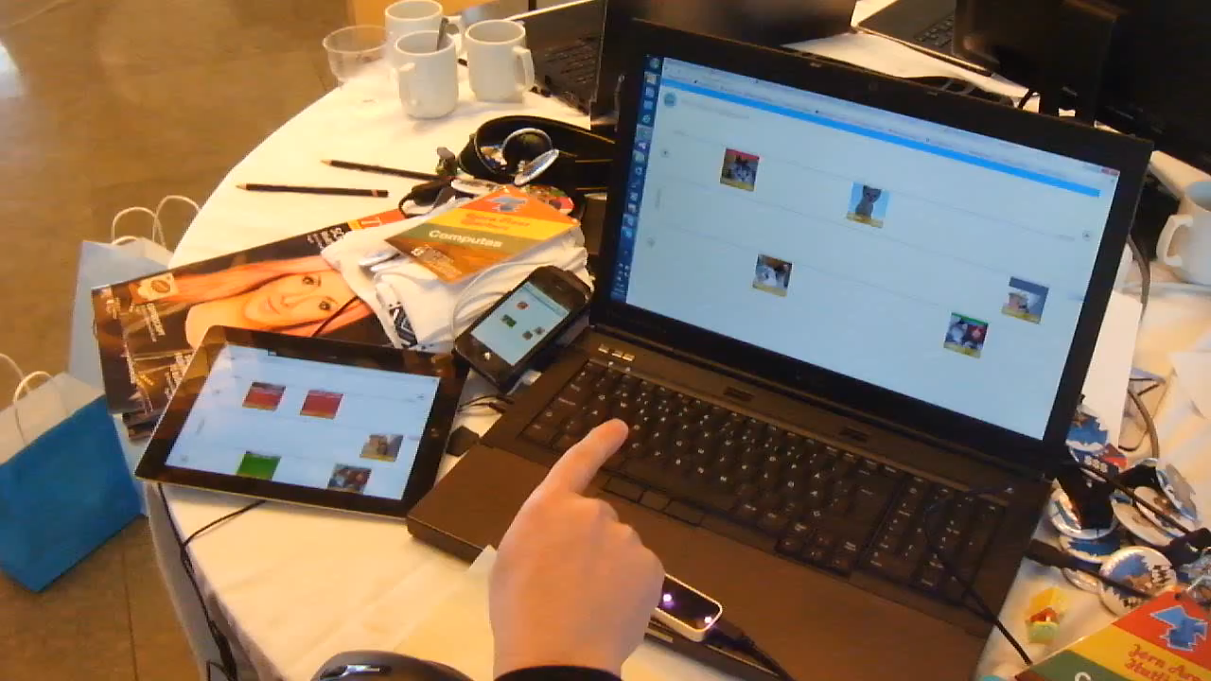
Notes:
Just to show what it is we are building, to avoid being to abstract.
Multi-user, real-time app. What you see here is a SharePoint task list, but it’s running in node.js with a custom interface.
Also using a leap motion device to do non-touch stuffl

Slide 3
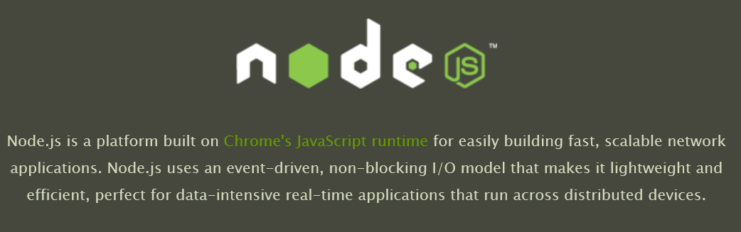
Notes:
Works on Windows, Linux and Mac. Has now professional support for stable releases.
Microsoft is using and support node use
It is more than just JavaScript on the server
Lean
Functionality in modules
NPM
You choose dev. env.
Hipster factor: Almost Erlang and Clojure

Slide 4
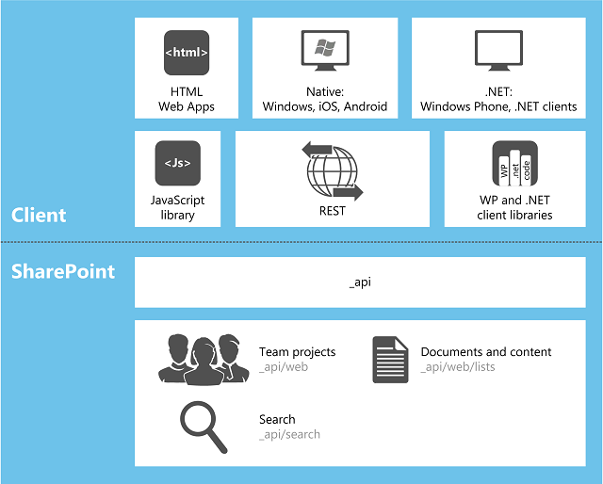
Notes:
Enterprisy monolithic product
IDE Driven Development assisted by wizards
Hipster factor: near zero

Slide 5

Notes:
Good Wizard

Slide 6
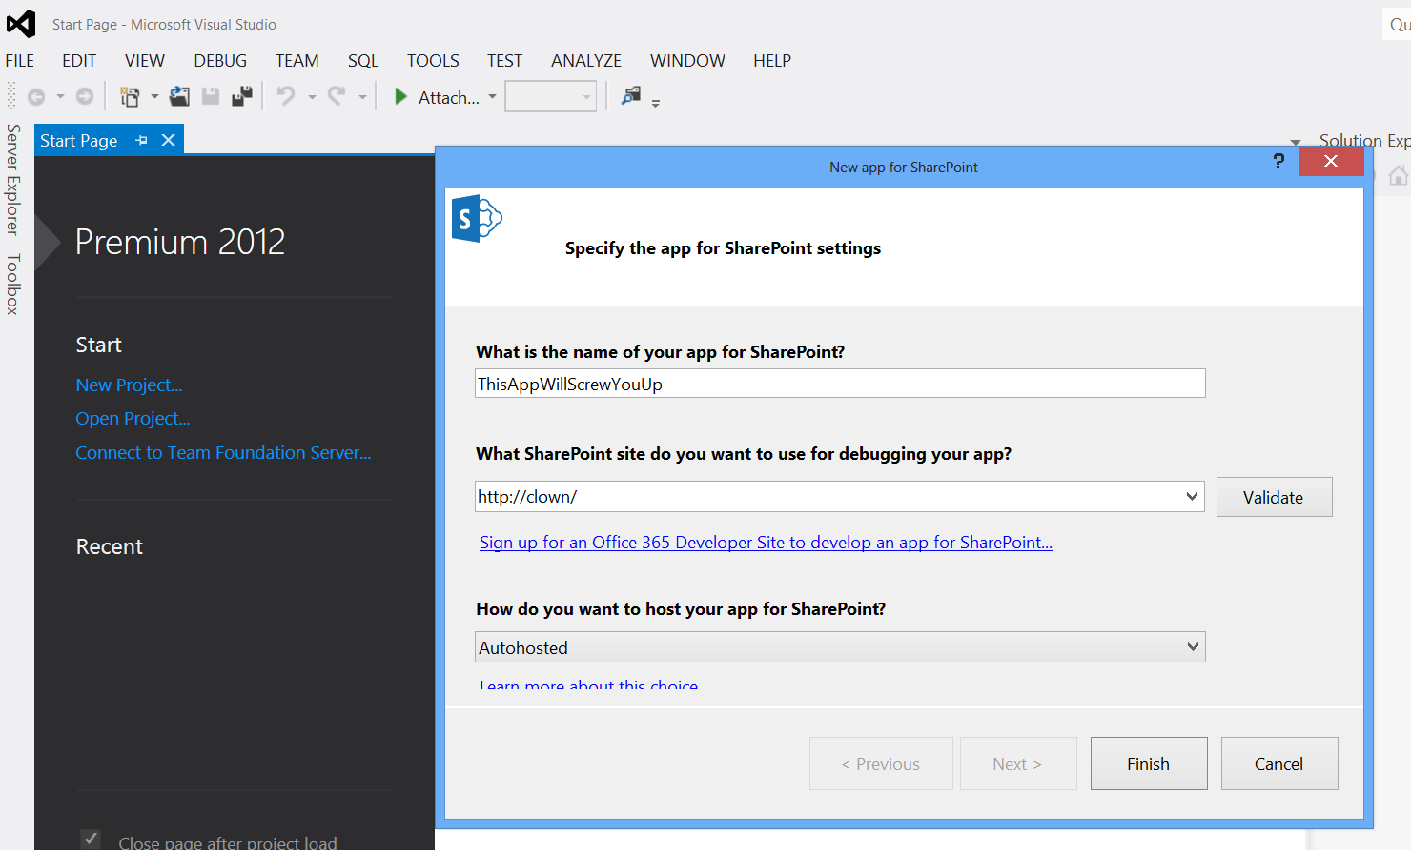
Notes:
Evil wizard
Blurring your eyes
You can no see or undertand what happens
Either someone solved the DevOps-thing witha dropdown OR this is a major leaky abstraction that
Will come back and haunt you.
TAKE THE RED PILL
This is not DevOps
Or, in case of SharePoint and Node.js > Eat both pills

Slide 7
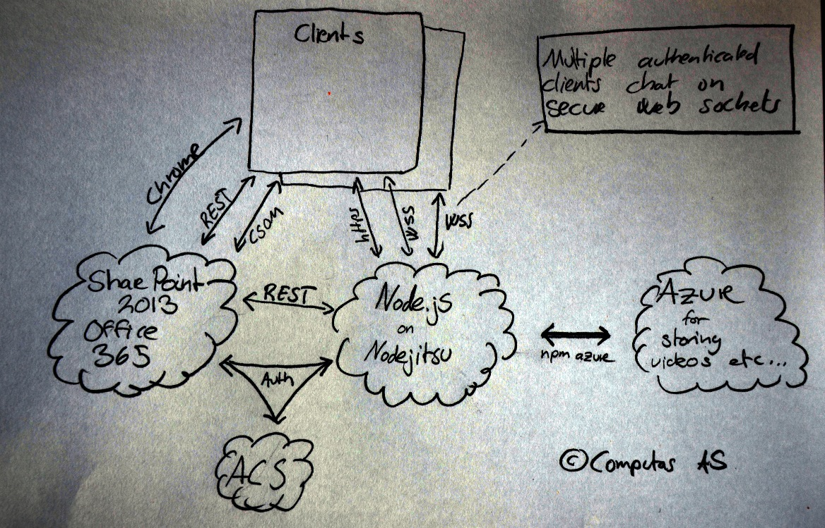
Notes:
THIS is what I mean with distributed network application. At least three servers, possibly more, and multiple clients. On the Internet. This is not traditional server-client model.
Enterprise clow is happy at this |. Can work with Linux of Mac, deploy using shell tools to cloud providers that specialize on Node.js hosting.
Developing SharePoint apps on Linux and hosting it on Linux makes the clown happy
This is really what a SharePoint App often is.
Distributed -> Runs in the cloud (SharePoint server, the client, ACS and third party services used)

Slide 8
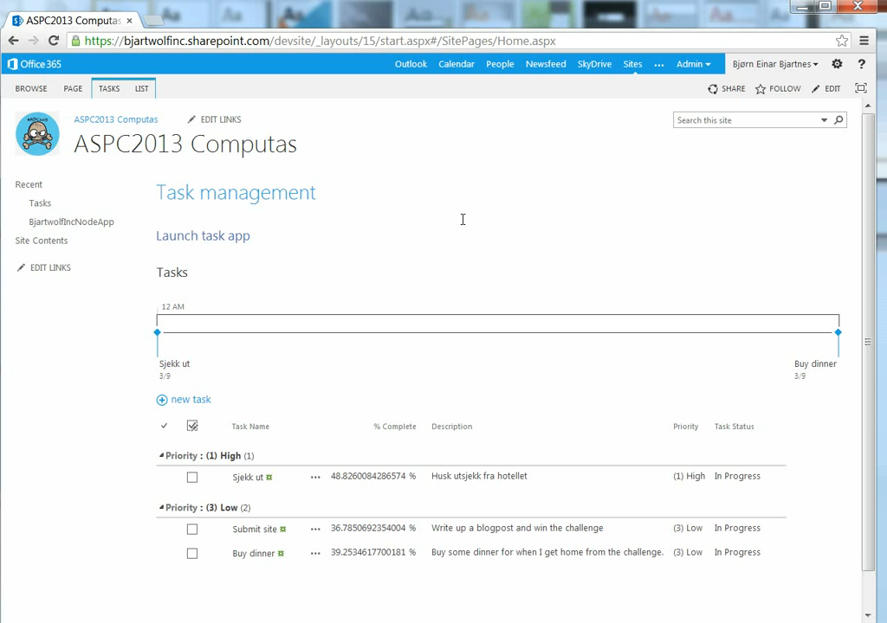

Slide 9
Results
Lightweight
Cheap to host and scale
Possible to understand
Leverage modules
npm
*nix processes

Slide 10
Macrauder at github.com/queport for the passport strategy
@askildt, @jornare for helping me building the app

Slide 11
«Dare to wear the foolish clown face»
Frank Sinatra

